Slide 1
Introduction to the Internet and Web

Slide 2
Internet
It is the largest network in the world that connects hundreds of thousands of individual networks all over the world.
The popular term for the Internet is the “information highway”.
Rather than moving through geographical space, it moves your ideas and information through cyberspace – the space of electronic movement of ideas and information.

Slide 3
Internet
No one owns it
It has no formal management organization.
As it was originally developed by the Department of Defense, this lack of centralization made it less vulnerable to wartime or terrorist attacks.
To access the Internet, an existing network need to pay a small registration fee and agree to certain standards based on the TCP/IP (Transmission Control Protocol/Internet Protocol)

Slide 4
Uses of the Internet
Send e-mail messages.
Send (upload) or receive (down load) files between computers.
Participate in discussion groups, such as mailing lists and newsgroups.
Surfing the web.

Slide 5
World Wide Web
Invented by Tim Berners-Lee in 1990
The invention was while working in CERN (the European Organization for Nuclear Research)
Tim Berners-Lee invented both the HTML and the HTTP protocol used to request and transmit web pages between web servers and web browsers

Slide 6
World Wide Web Consortium (W3C)
Founded by Tim Berners-Lee in 1994
devoted to developing nonproprietary, interoperable technologies for the World Wide Web
also a standardization organization
Web technologies standardized by the W3C are called Recommendations (role, syntax, rules, etc..)
(e.g) HTML, CSS, XHTML, XML

Slide 7
What is WWW?
The World Wide Web (www) is an open source of information space where documents and other web resources are identified by URLs, interlinked by hypertext links, and can be accessed via the Internet

Slide 8
What is Web?
Consists of information organized into Web pages containing text and graphic images
Highlighted keywords and images that lead to related information
A collection of linked Web pages that has a common theme or focus is called a Web site
The main page that all of the pages on a particular Web site are organized around and link back to is called the site’s Home page

Slide 9
How to access the Internet?
To access the Internet, an existing network need to pay a small registration fee and agree to certain standards based on the TCP/IP (Transmission Control Protocol/Internet Protocol) reference model.
Each organization pays for its own networks and its own telephone bills, but those costs usually exist independent of the internet.
The regional Internet companies route and forward all traffic, and the cost is still only that of a local telephone call.

Slide 10
Internet Service Provider (ISP)
A commercial organization with permanent connection to the Internet that sells temporary connections to subscribers
Examples:
Prodigy, America Online, Microsoft network, AT&T Networks.

Slide 11
How to access the Web?
Once you have your Internet connection, then you need special software called a browser to access the Web
Web browsers are used to connect you to remote computers, open and transfer files, display text and images.
Web browsers are specialized programs.
Examples of Web browser: Netscape Navigator (Navigator) and Internet Explorer

Slide 12
Client/Server Structure of the Web
Web is a collection of files that reside on computers, called Web servers, that are located all over the world and are connected to each other through the Internet.
When you use your Internet connection to become part of the Web, your computer becomes a Web client in a worldwide client/server network.
A Web browser is the software that you run on your computer to make it work as a web client.

Slide 13

Architecture of WWW

Slide 14
Types of Web Documents
The documents in the WWW can be grouped into three broad categories: static, dynamic, and active
The category is based on the time at which the contents of the document are determined

Slide 15
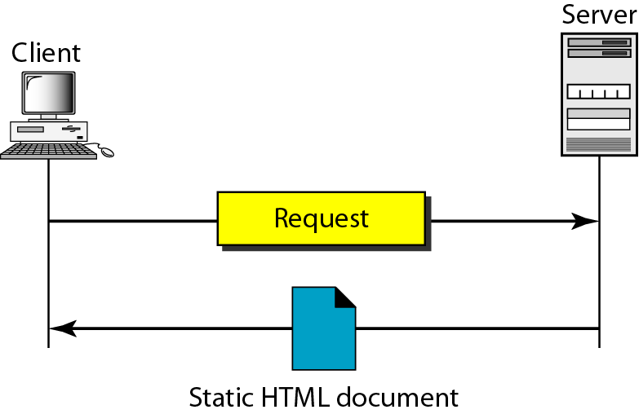
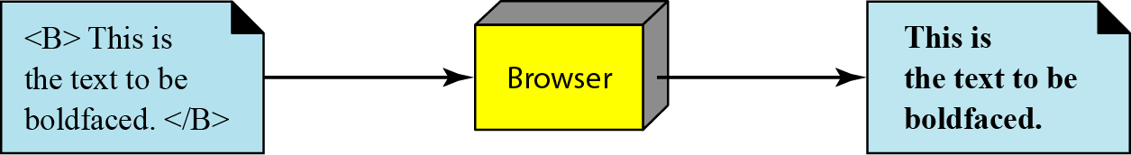
Static document

Slide 16
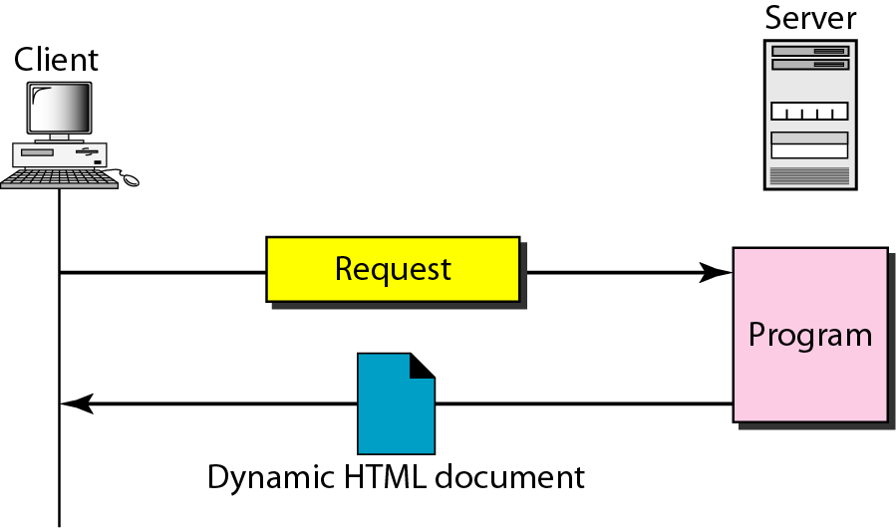
Dynamic document using PHP

Slide 17
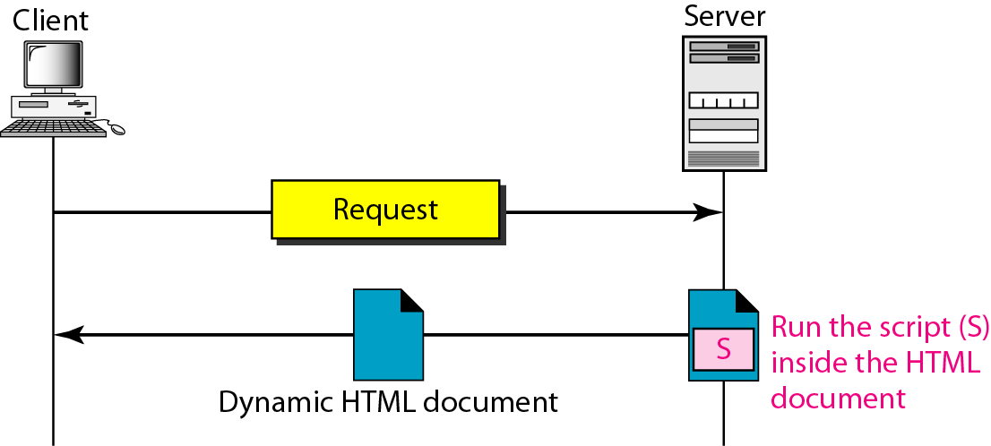
Dynamic document using Server-side Script
Dynamic documents are sometimes referred to as server-side dynamic documents.

Slide 18
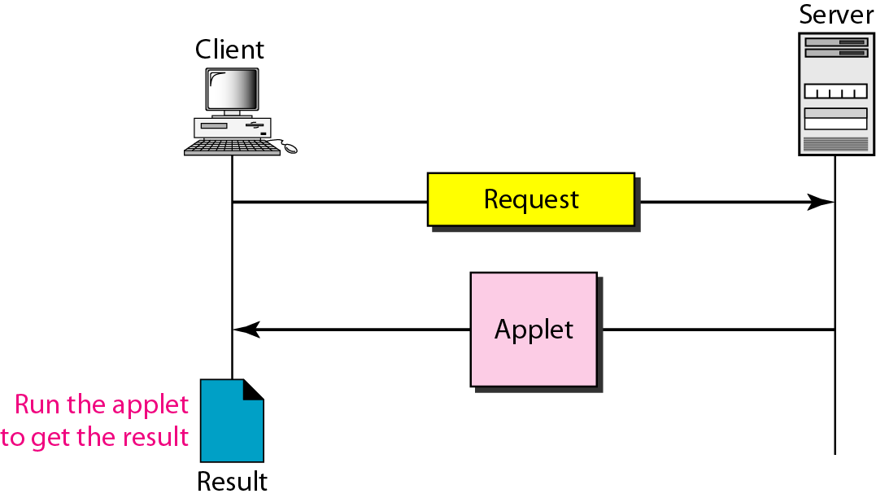
Active document using Java Applet

Slide 19
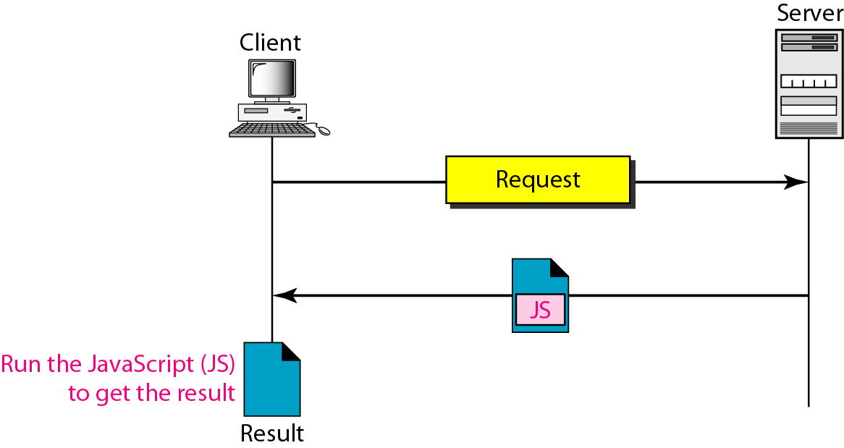
Dynamic document using Client-side Script
Active documents are sometimes referred to as client-side dynamic documents.

Slide 20
Addresses on the Web:IP Addressing
Each computer on the internet does have a unique identification number, called an IP (Internet Protocol) Address
The IP addressing system currently in use on the Internet uses a four-part number
Each part of the address is a number ranging from 0 to 255, and each part is separated by period
For example, 106.29.242.17

Slide 21
IP Addressing
The combination of the four IP address parts provides 4.2 billion possible addresses (256 x 256 x 256 x 256)
This number seemed adequate until 1998
Members of various Internet task forces are working to develop an alternate addressing system that will accommodate the projected growth
However, all of their working solutions require extensive hardware and software changes throughout the Internet

Slide 22
Domain Name Addressing
Most web browsers do not use the IP address to locate Web sites and individual pages
They use domain name addressing
A domain name is a unique name associated with a specific IP address by a program that runs on an Internet host computer
This program, which coordinates the IP addresses and domain names for all computers attached to it, is called DNS (Domain Name System ) software
The host computer that runs this software is called a Domain Name Server

Slide 23
Uniform Resource Locators
The IP address and the domain name each identify a particular computer on the Internet.
However, they do not indicate where a Web page’s HTML document resides on that computer.
To identify a Web pages exact location, Web browsers rely on Uniform Resource Locator (URL)
URL is a four-part addressing scheme that tells the Web browser:
Transfer Protocol
Domain name of the computer on which the file resides
Pathname of the folder or directory on the computer on which the file resides
Name of the file

Slide 24
Structure of a Uniform Resource Locators
pathname
protocol
http://www.chicagosymphony.org/civicconcerts/index.htm
Domain name
filename
http => Hypertext Transfer Protocol

Slide 25
Browser Architecture

Slide 26
What is the Browser?
The browser main functionality is to present the web resource you choose, by requesting it from the server and displaying it on the browser window. The resource format is usually HTML but also PDF, image and more.

Slide 27
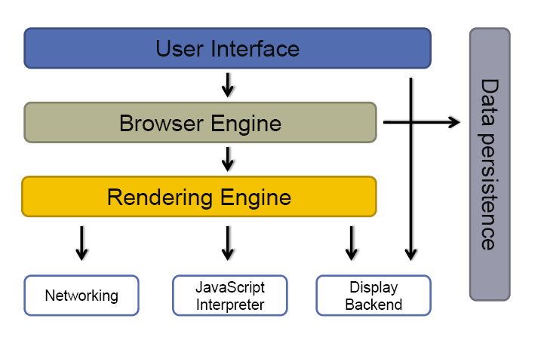
Browser Architecture

Slide 28
User Interface
The space where interaction between users and the browser
Most of the browsers have common inputs for user interface:
Address bar.
Next and back buttons.
Buttons for home, refresh and stop
Bookmark web pages
…etc.

Slide 29
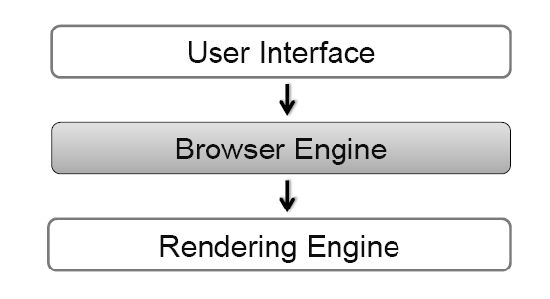
Browser Engine
The bridge between User Interface & Rendering Engine
Browser Engine provides methods to begin the loading of URL and other high-level browsing actions
Reload, Back, Forward actions
Error messages
Loading progress

Slide 30
Rendering Engine
Rendering Engine interprets (render) the HTML, XML, JavaScript and generates the layout that is displayed in the User Interface

Slide 31
Networking
Access and transfer data on the internet (calls HTTP, HTTPS, FTP)
The Networking components handles all aspects of internet communication or security

Slide 32
JavaScript Interpreter
Component parse & executes the JavaScript that is embedded in the website
Results of the execution a passed to the Rendering Engines for display

Slide 33
Display Backend
Display common UI components
Drawing basic widgets like combo boxes, windows

Slide 34
Data Persistence
Storing the data on the client side.
Cookies
Cache

Slide 35
Web Server Architecture
Web server architecture is the logical layout or design of a web server, based on which a web server is designed, developed and deployed.
It defines the architectural layout and components of a web server, essential for delivering the required web server-based operations and services.

Slide 36
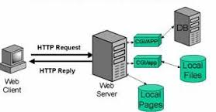
Web Server Architecture

Slide 37
Web Server Architecture
Web server architecture consists of parameters including, but not limited to:
Physical capacity of the server in terms of computing power, storage and memory
Performance and quality of service (latency, throughput, low memory utilization)
Application tiers (type of different applications deployed on the server)
Platform supported (.Net, LAMP)
Operating system (Windows, Linux, Solaris)
Network and/or Internet connectivity (modes of connection and the number of concurrent users it can support)

Slide 38
Exercises
Comparison of IPv4 & IPv6
Study about the Brower Architecture
  Firefox
  Study about the Server Architecture
  Apache Web Server

